Slide 1

EDA - Spotify
Stavros Tsiloglou

Slide 2
Exploration
Top Genres
Total Streams
Top Artists
How all the above function with time
Project EDA - Spotify
Stavros Tsiloglou

Slide 3
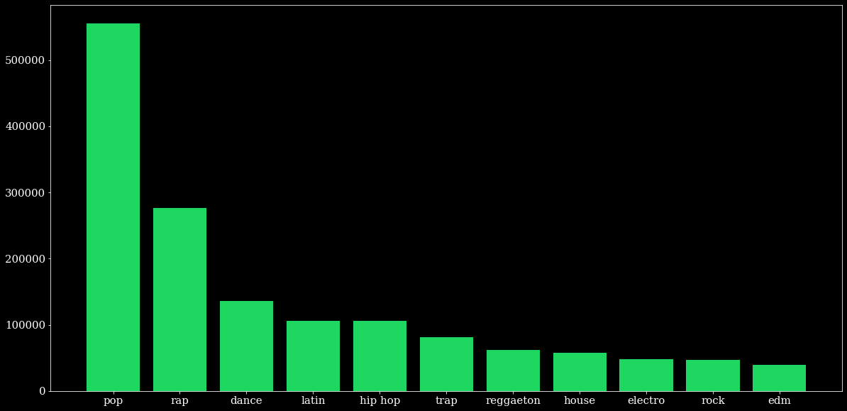
Top Genres
Project EDA - Spotify
Stavros Tsiloglou

Slide 4
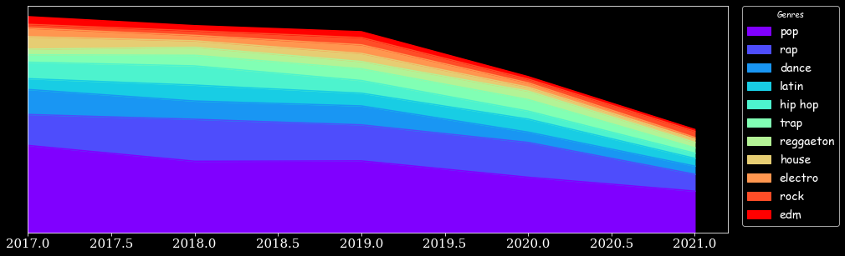
Genres through Time
Project EDA - Spotify
Stavros Tsiloglou

Slide 5
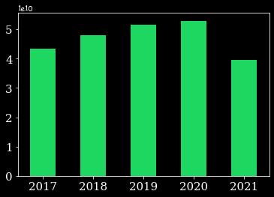
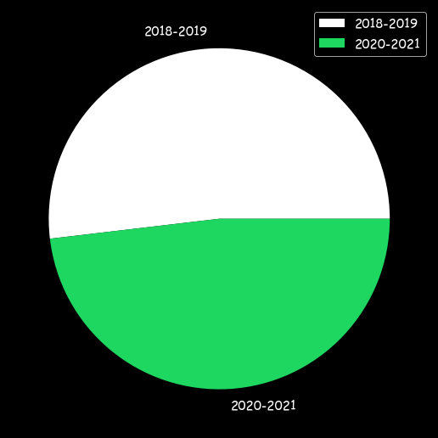
Total Streams (Units per 10b)
Project EDA - Spotify
Stavros Tsiloglou

Slide 6
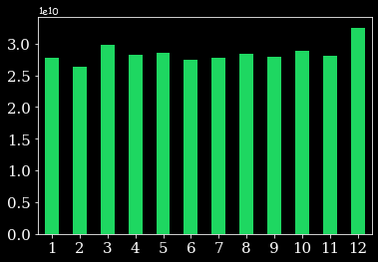
Total Streams (Units per 10b)
Project EDA - Spotify
Stavros Tsiloglou

Slide 7
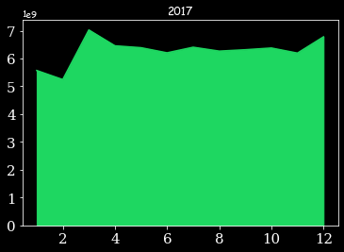
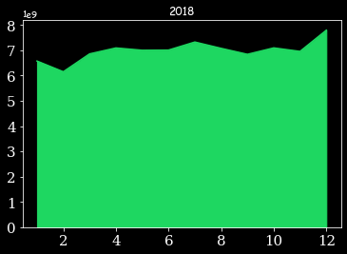
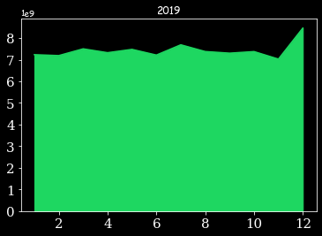
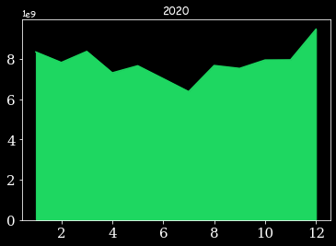
Total Streams (Units per 1b)
Project EDA - Spotify
Stavros Tsiloglou

Slide 8
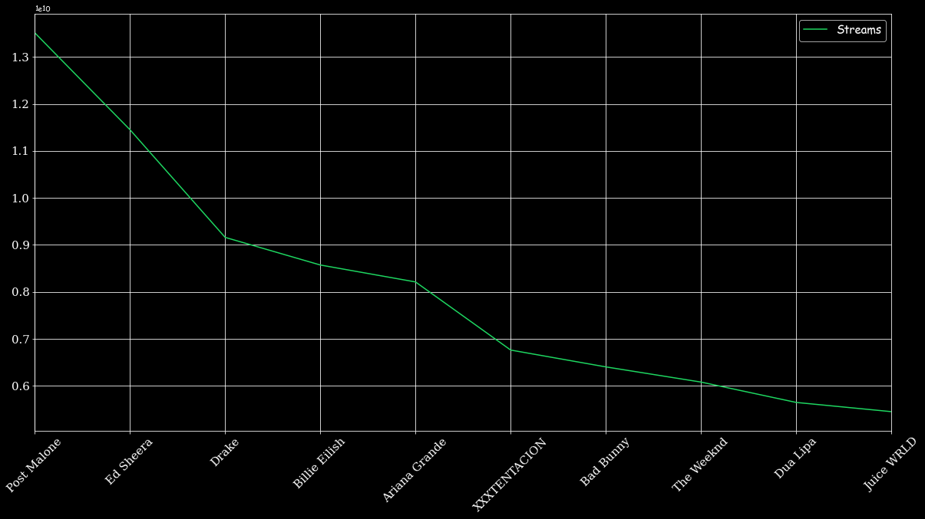
Top Artists (Units per 10b)
Project EDA - Spotify
Stavros Tsiloglou

Slide 9
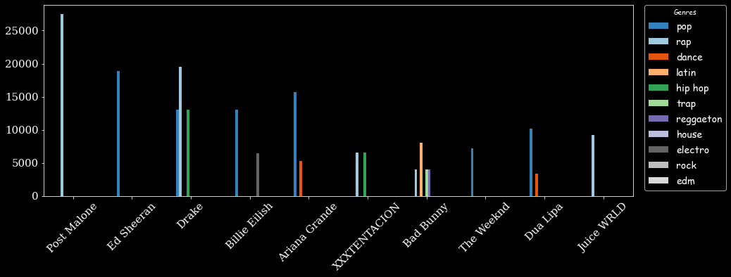
Genres of Top Artists
Project EDA - Spotify
Stavros Tsiloglou

Slide 10
Sources
https://www.kaggle.com/
Spotify daily top 200 songs 2017-2021 Dataset
Google
Thank You For Listening!
Project EDA - Spotify
Stavros Tsiloglou

